Slide 1

Autonomous Weapons Are there ever situations where it could be condoned?
By Konstantinos Christodoulou

Slide 2
Outline
Lethal autonomous weapons
Ethical and security issues
Reliable applications
Summary

Slide 3
1.0 Lethal Autonomous Weapons - Definition
Technologies controlled by computer and run on artificial intelligence systems
Programmed to select and engage targets - without further intervention by a human operator
Swarm robots: interconnected, cooperative drones that are capable of working together to overwhelm adversaries. And when it comes to the battlefield, numbers matter!
Eliminating/reduce the human operator:
- the soldiers that never sleep (killer robots)
- can coordinate on a scale that would be impossible for humans

Slide 4
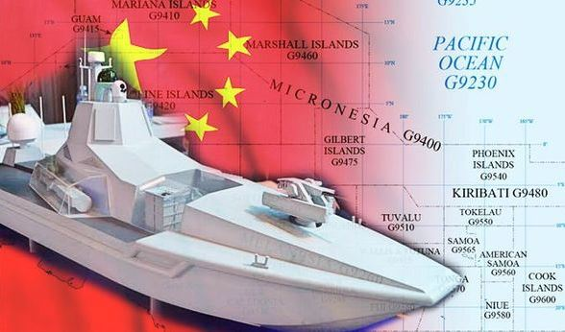
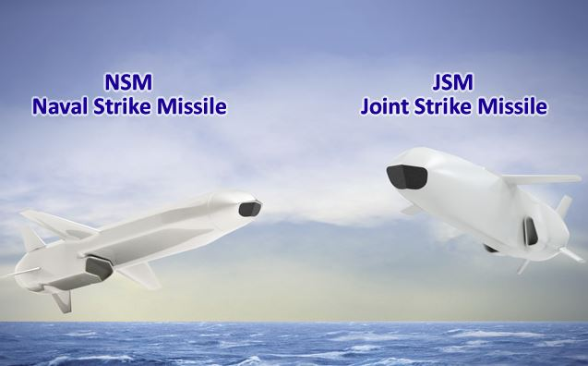
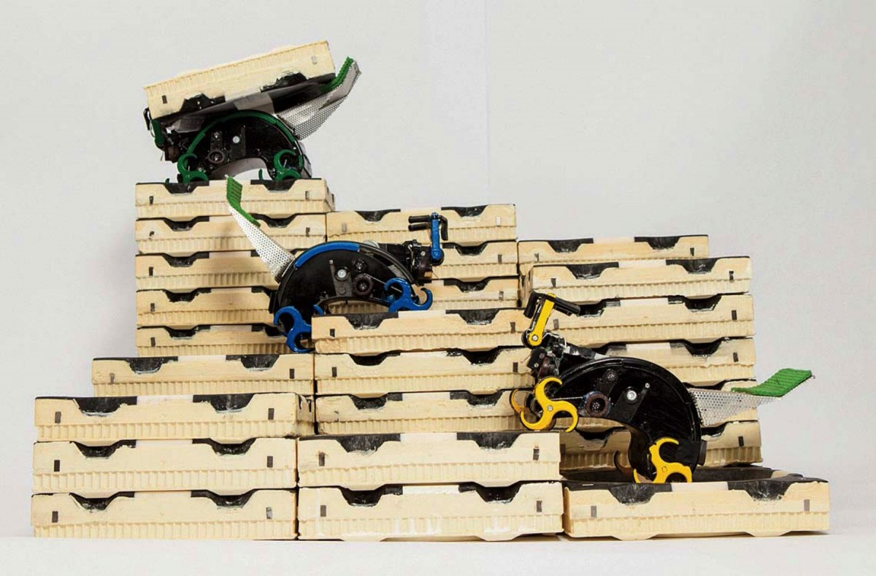
1.1 Lethal Autonomous Weapons - Examples
Autonomous robot warship
Autonomous long range missiles
Autonomous termites
15 meters and weights 20 tons.
Capable of conducting commands.
Unmanned destroyer.
Remotely controlled.
Uses AI to autonomously navigate
and undertake combat activities.
Long distance aerial weapon.
Detect threats on its own.
Ability to fly low under the radar.
Keep pilots and their aircraft out
of harm’s.
Each one has its own brain.
Self-organised and working together.
Come in different shapes and sizes.
Can spread out over large areas for:
- perform reconnaissance.
- search and rescue missions.

Slide 5
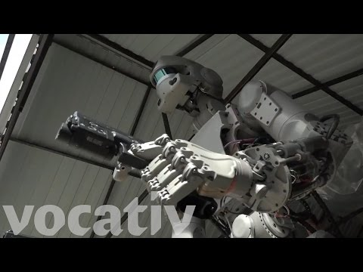
1.2 Lethal Autonomous Weapons - Examples

Slide 6
1.3 Lethal Autonomous Weapons – Thoughts?
JUST DON’T LOOK AT HIM IN THE WRONG WAY
THOUGHTS?

Slide 7
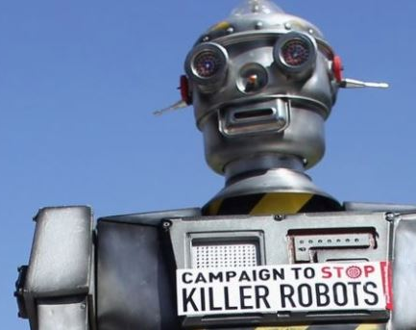
2.0 Ethical issues

Slide 8
2.1 Ethical and security issues
Worldwide concern has been growing about the idea of developing LAW that take human beings “out of the loop”
116 experts are calling for a ban on the use of AI in managing weapons, including,
- Elon Musk (CEO & CTO of SpaceX, CEO of Tesla Motor)
- Alfonso Iniguez (founder & CEO of Swarm Technology)
- Mustafa Suleyman (co-founder of Google’s DeepMind)
- Steve Wozniak (Apple co-founder)
Stephen Hawking warned about the dangers of artificial intelligence

Slide 9
2.2 Ethical and security issues
What if they could be hacked?
Biases
Violation of human rights
"The power to decide over life and death should never be taken out of human hands and given to machines“

Slide 10

3.0 Reliable
applications

Slide 11
3.1 Reliable applications
Verification and Validation techniques
Can they be reliably applied in war ?
Reduce PTSD in soldiers

Slide 12
4.0 Summary
Develop autonomous robots but not autonomous enough
Autonomous robots can be used or adopted in different fields, including, police forces and rescue services
Robots are necessary for space missions and space exploration

